Slide 1


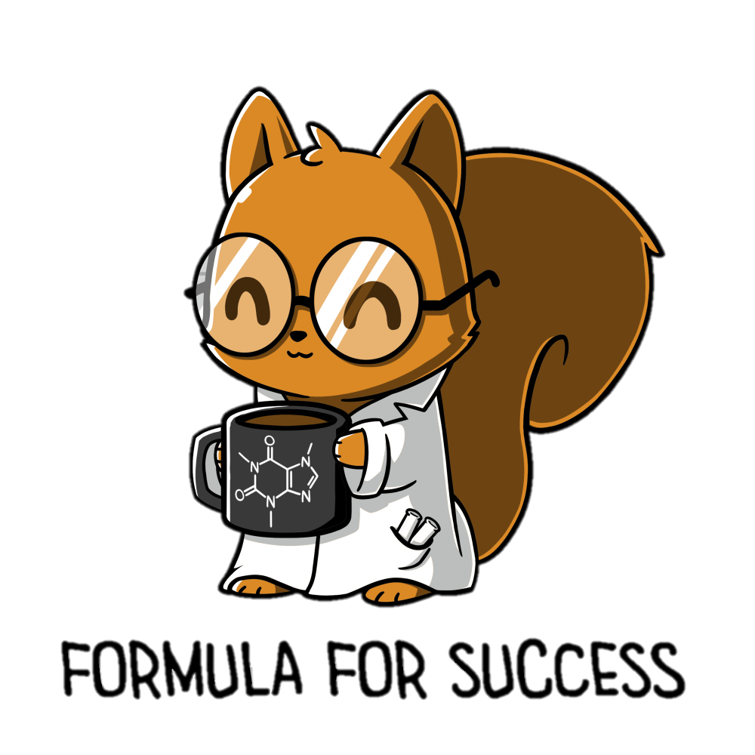





Oct
08
We are learning about Stars
Describe the stages of a star’s lifecycle
Describe the characteristics of each stage
Describe the possible pathways a star can take
Workbook or laptop (for writing)
Pen
Explain the difference between red shift and blue shift.
Learning about the lifecycle of a star
Applying understanding
Notes:
Font: Coconutz by typefactory on fontspace.com

Slide 2
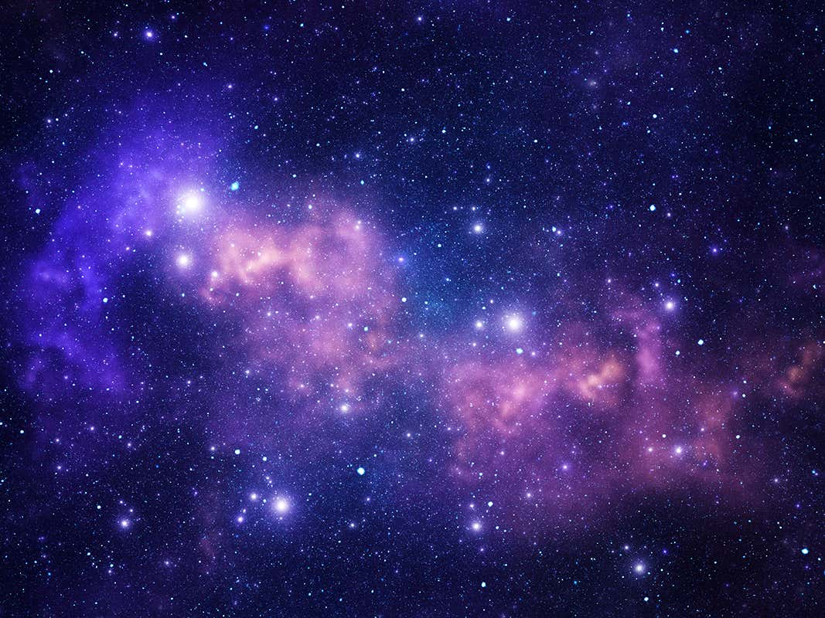
Stars
We are learning about Stars
A star is a huge object in space that emits light and infrared radiation due to nuclear fusion at its core.
Stars are mostly made of helium and hydrogen.
All naturally occurring elements are produced by the fusion processes in stars.

Slide 3
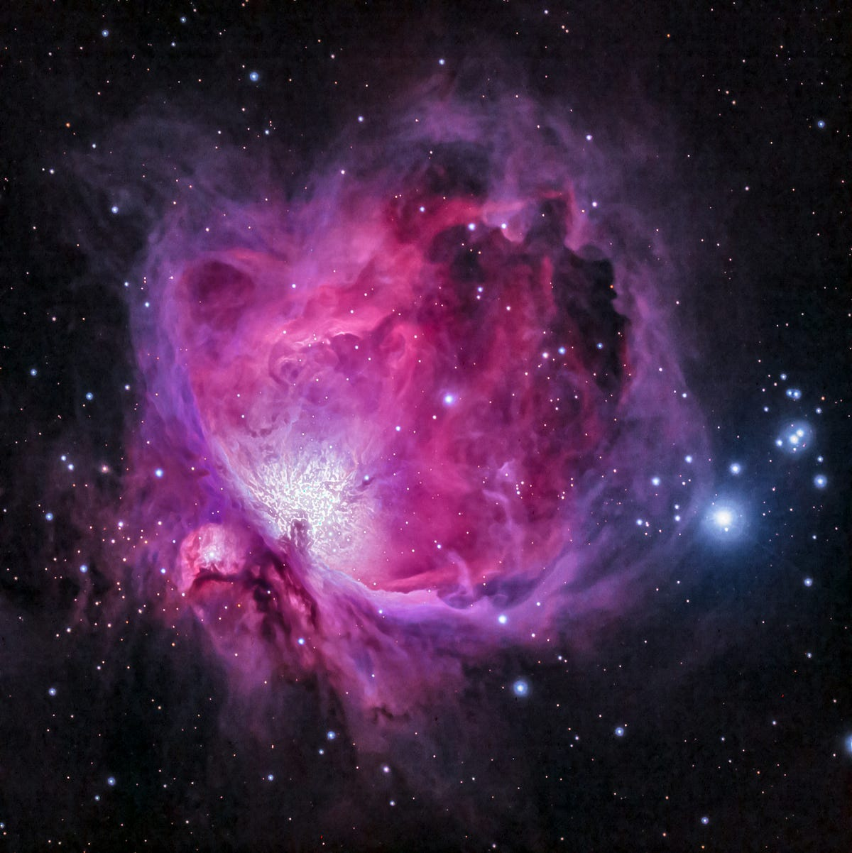
Stars - Nebula
We are learning about Stars
A Nebula is the first stage of the star’s lifecycle.
It is a big cloud of dust and mostly hydrogen gas.
Gravitational forces pull the particles closer together, causing the cloud to get hotter and denser.

Slide 4
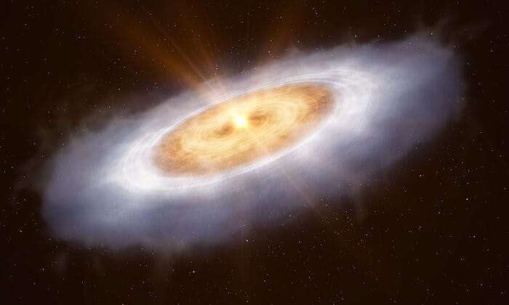
Stars - Protostar
We are learning about Stars
The next stage is the Protostar.
The friction caused when the particles brush past each other increases the thermal energy store.
Light starts to be emitted

Slide 5
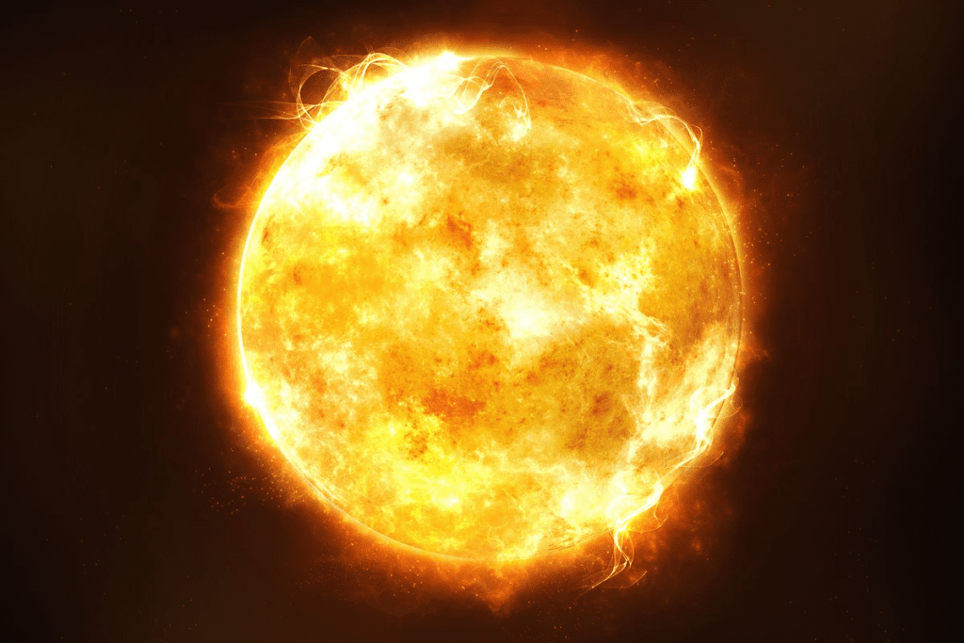
Stars – Main Sequence Star 1
We are learning about Stars
Main sequence star is the next stage.
When the hydrogen nuclei gain enough energy, they eventually fuse together, forming helium nuclei. This process is nuclear fusion.
The fusion increases the thermal energy store in the center of the star, causing it to expand.

Slide 6
Stars – Main Sequence Star 2
We are learning about Stars
The sun in our solar system is a main sequence star.
The larger the star, the faster it moves through the main sequence star phase.
The next stage of the life cycle depends on the size of the star.

Slide 7
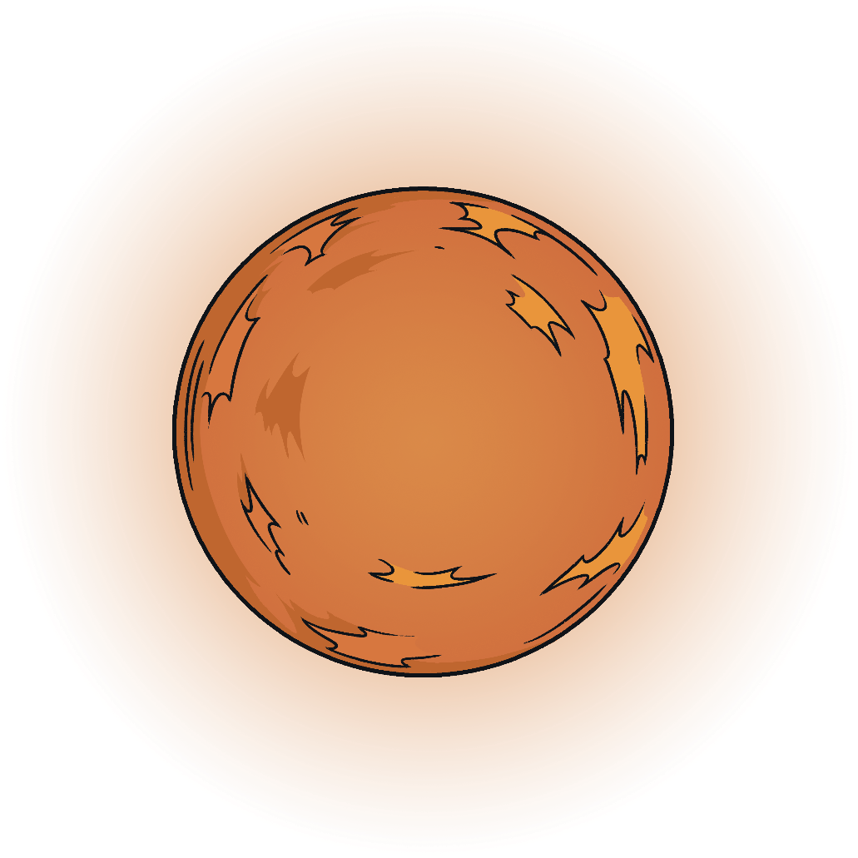


Stars – Main Sequence Star 3
We are learning about Stars
The fusion of larger nuclei in the star’s core to make heavier elements causes an increase in the thermal energy store, making the star rapidly expand.
Stars about the same size as the Sun will form Red Giants
Stars much larger than the Sun will form Red Super-giants.
Main Sequence Star
Red Giant
Red Super-Giant

Slide 8

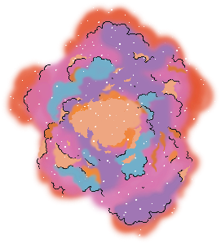
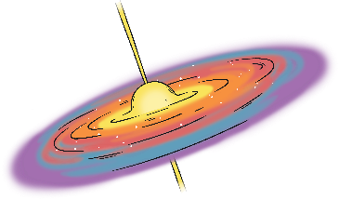



Stars – The Size of the Sun
We are learning about Stars
A star approximately the same size as the Sun will follow the below path after the main sequence star…
Complete the diagram in your book
nebula
protostar
main sequence
star
red giant
white dwarf
black dwarf

Slide 9
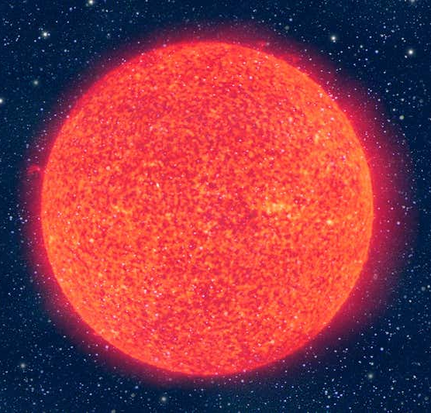


Stars – Red Giant
We are learning about Stars
As the main sequence star expands to form the red giant, it cools. This cooling is what causes the star to look more red.
The Red Giant is larger than the main sequence star, making it brighter.
Carbon and Oxygen can be made by fusion in the Red Giant stage.
The Sun in our solar system will become a red giant in approx. 5 million years.
main sequence star
red giant

Slide 10
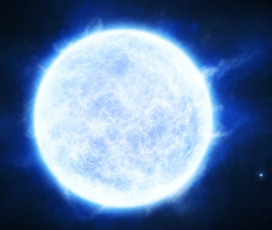
Stars – White Dwarf
We are learning about Stars
At the end pf the red giant stage, fusion stops and the gravitational forces acting inwards are stronger than the expansive forces acting outwards.
This causes the star to collapse inwards.
The outer layers of the star are expelled, and the leftover core is known as a White Dwarf.
White Dwarf stars are very bright and very hot because their energy is condensed into a small area.

Slide 11
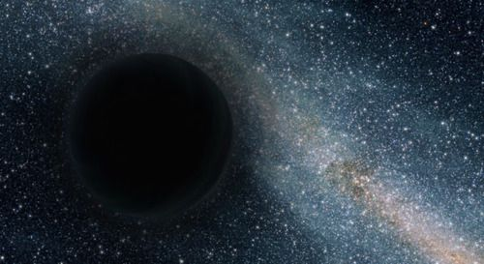
Stars – Black Dwarf
We are learning about Stars
Over time, energy is emitted from the white dwarf star to the surroundings.
The star gets dimmer and dimmer until it turns into a brown, then a Black Dwarf Star.

Slide 12

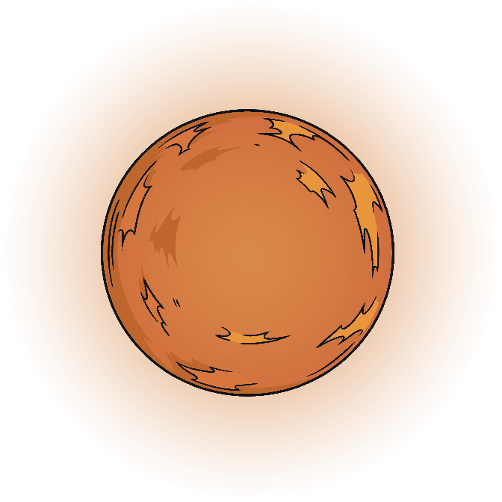




Stars – More Massive than the Sun
We are learning about Stars
A star more massive than the Sun will follow the below path after the main sequence star…
Complete the diagram in your book
neutron star
nebula
protostar
main sequence
star
red supergiant
black hole

Slide 13
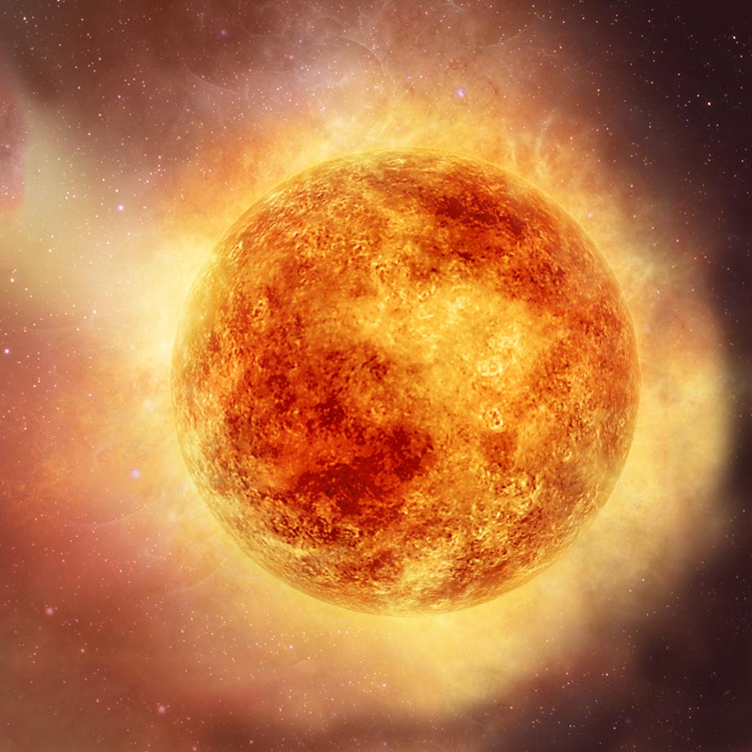
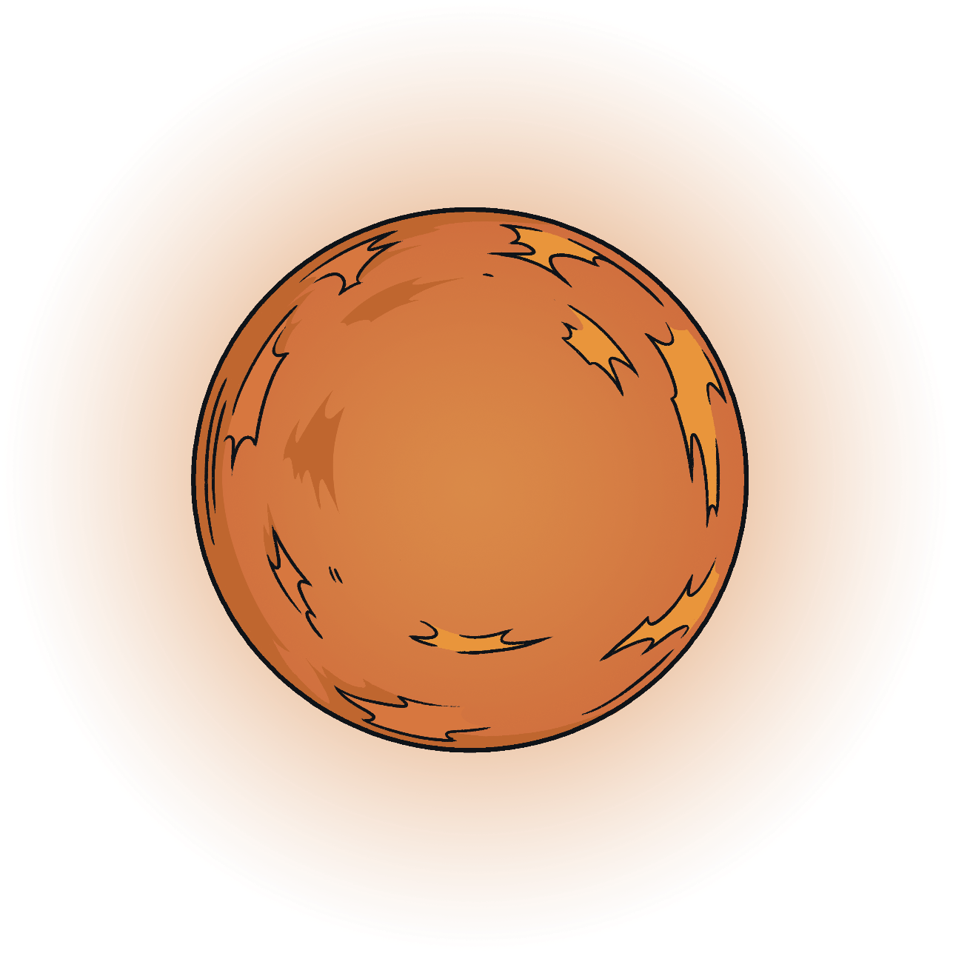

Stars – Red Supergiant
We are learning about Stars
Main sequence stars that are much larger than the Sun will form Red Supergiant’s when they expand.
Elements up to the size of Iron can fuse in a red supergiant.
red giant
red supergiant

Slide 14
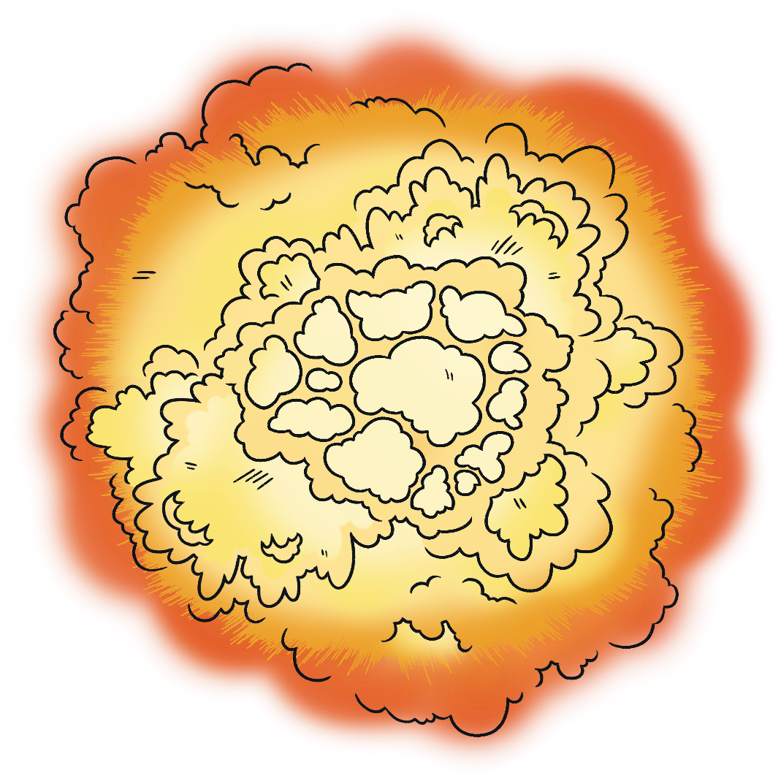


Stars – Supernova 2
We are learning about Stars
The size of the supernova will determine the next stage of the star’s life cycle.
Most supernovae form Neutron Stars.
The largest supernovae form Black Holes.
Supernova
Neutron Star
Black Hole

Slide 15
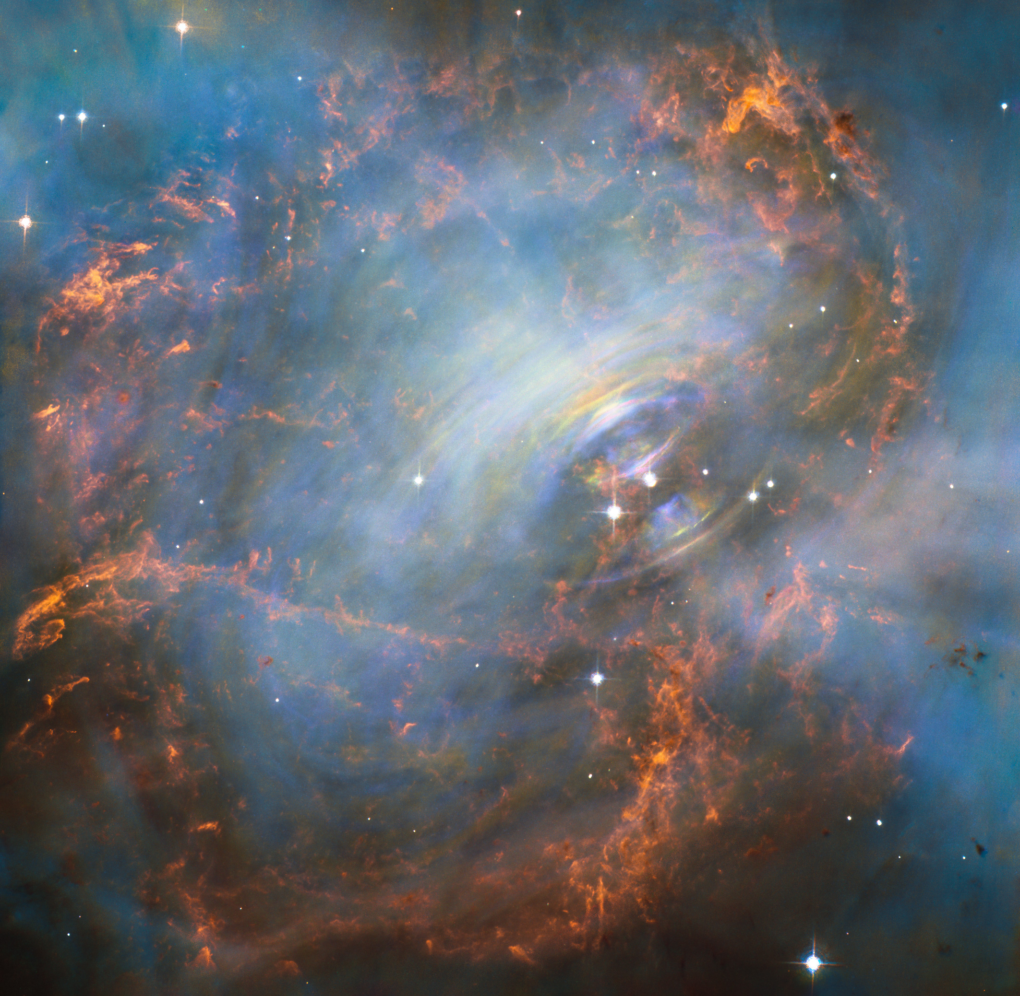
Stars – Supernova
We are learning about Stars
At the center of a supernova, the particles form an incredible dense core.
This causes the supernova to collapse into a Neutron Star.
Neutron stars are the smallest and densest known star.
Fusion does not occur at this stage.

Slide 16
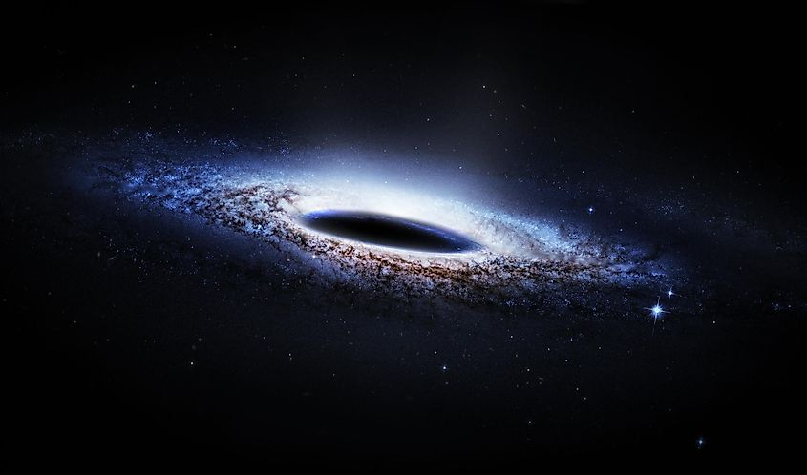
Stars – Black Hole
We are learning about Stars
The largest supernovae collapse to form Black Holes.
Gravity in a black hole is so strong not even light can escape.
The name might make you think empty space, but there is a huge amount of matter packed into a tiny area.

Slide 17




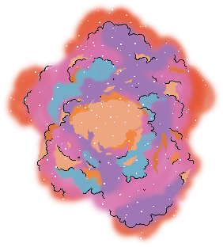


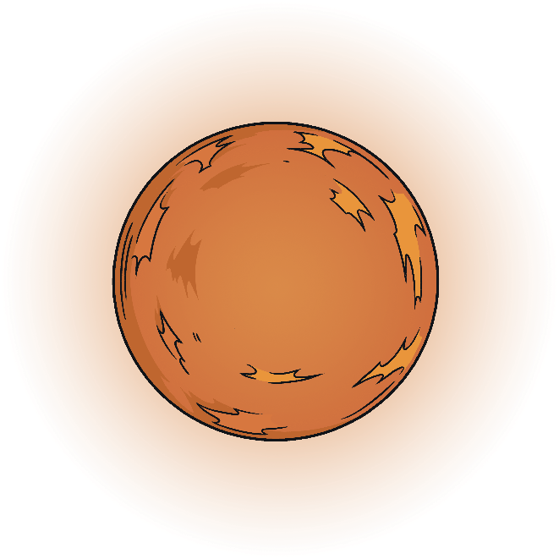
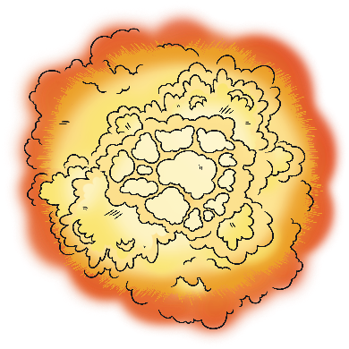

Life Cycle of a Star
We are learning about Stars
about the same size as the sun
white dwarf
black dwarf
red giant
main sequence star
protostar
nebula
neutron star
more massive than the sun
red supergiant
supernova
black hole

Slide 18


June
08
Classroom expectations
Describe the stages of a star’s lifecycle
Describe the characteristics of each stage
Describe the possible pathways a star can take
Notes:
Font: Coconutz by typefactory on fontspace.com

Slide 19
* BRAIN BREAK *
Touch your left ear with your right hand.
Now take a deep breath and close your eyes.
On each count, take a deep breath in, and release.
Now, touch your nose with your left hand
Now switch… right ear and left hand, nose with right hand
And switch… left ear and right hand, nose with left hand
Notes:
Get students to complete brain break exercise then do a deep cleansing breath to release and resettle.
Instruct students to take a deep breath and close their eyes.
Slowly count down from 5 and tell students to take a deep breath on each count.
At 1, tell students to open their eyes and resume the lesson.

Slide 20
Close your books and put them away
Form 5 groups
Get your brain ready…
It’s time to play attack!

Slide 21
GAME RULES
1. Only the selected person on the team can answer the question (no help!)
2. If you get the answer right you get to attack! Get it wrong, another team gets a go.
3. Once you’ve been attacked 5 times, that team can’t win (but you can still attack others).
4. Last team standing wins!

Slide 22
Put your books away
Collect a whiteboard, marker & cloth
New Rule:
Each correct answer gets a point… top 3 most points get lollies!
Get your brain ready…
It’s time to test your knowledge!

Slide 23
Quiz:
1. Which answer makes use of metals being ductile?
Electrical wiring
Drink can
Jewellery
Tin foil
2. Which answers makes use of metals being malleable?
Supporting a building with steel rods
Hammering a nail into a board
Making jewellery
Bending Aluminium to make drink cans

